Slide 1
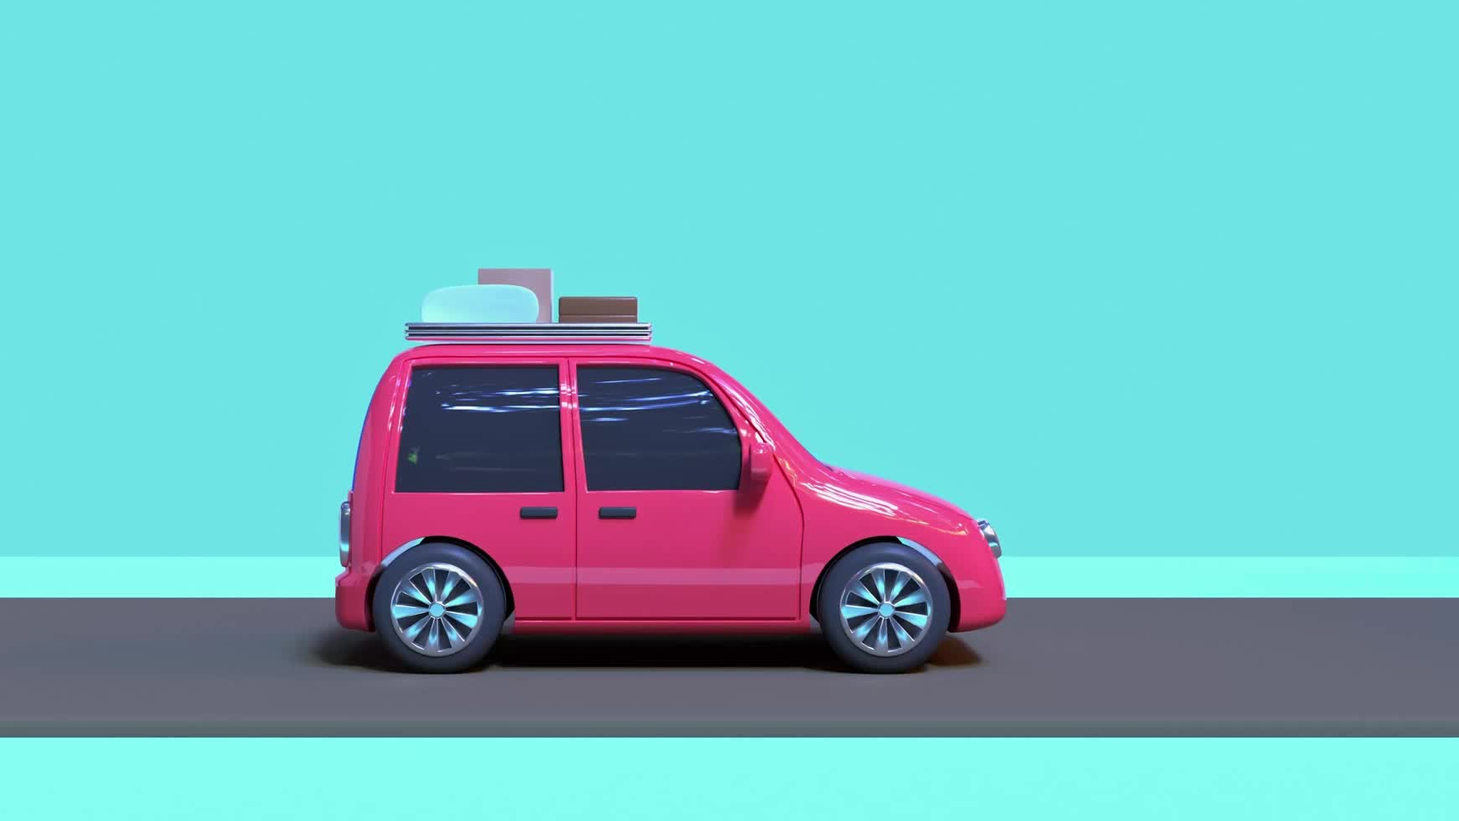
Autonomous Car With BlueTooth Mode

Slide 2
Components
1- AT_MEGA32 2-Bluetooth Modules(HC-05)
3-Ultrasonic sensor 4-Servo Motor
5-LCD 6-POT Resistance 5K
7-LEDS *6 8-Resistance 330ohm *6
9-power bank 10-TTL *2
11-DC Motor *4 12-L293D driver
13-BUZZER 14-Transistor (2N2222)
15-Chassis 16-Push button
17-Crystal oscillator(16MHZ) 18-Capacitor (22pF) *2
19-Jumper wires 20-Test Board

Slide 3
Project Objective:
A simple car connected to a Mobile(wireless [Bluetooth]), having 2 modes of operation, that the user can select through the GUI. The first mode is manual mode, where the user can control car movements through the GUI using buttons. The second mode is autonomous mode, when selected through GUI by user, in which the car keeps moving while avoiding collisions using its on-board sensors (ultrasonic). In all modes,

Slide 4
First Mode
Ultrasonic Autonomous Navigation
#### Hardware:
• Ultrasonic sensors, strategically placed on the autonomous car, provide distance measurements to detect obstacles in the environment.
#### Control System:
• The car's microcontroller (AVR ATmega32) processes data from the ultrasonic sensors to make real-time decisions.

Slide 5
Second Mode
Wireless Control
#### GUI (Mobile Application ):
The interface allows users to set destinations, control movement, and monitor the vehicle's surroundings.
#### Control System:
• The car's microcontroller (AVR ATmega32) processes data from the Bluetooth to make real-time decisions.

Slide 6
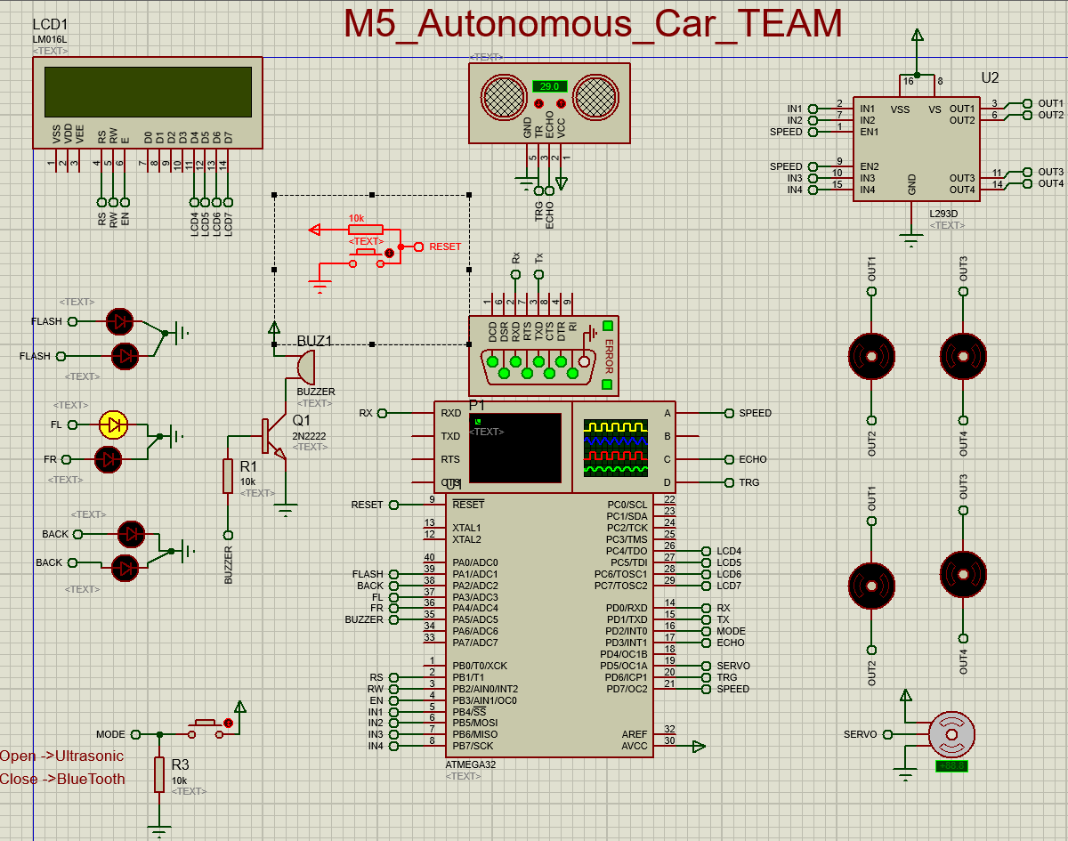
Circuit diagram

Slide 7
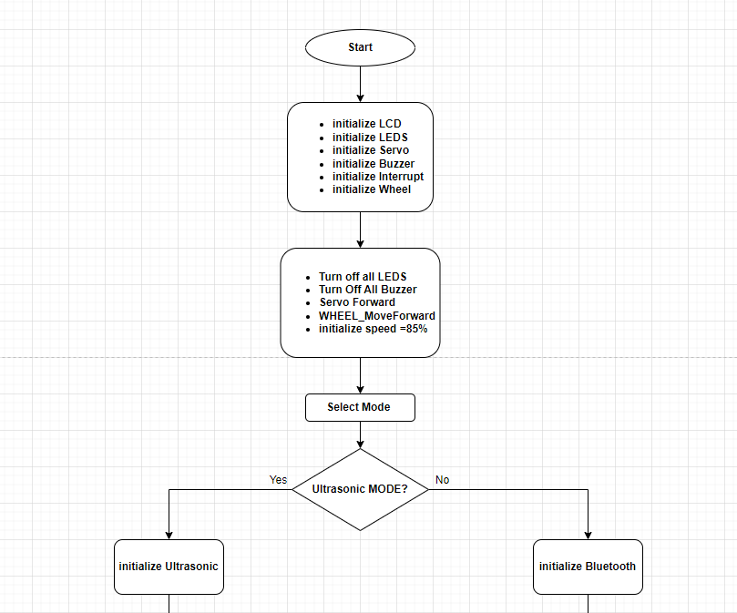
Flow Diagram

Slide 8
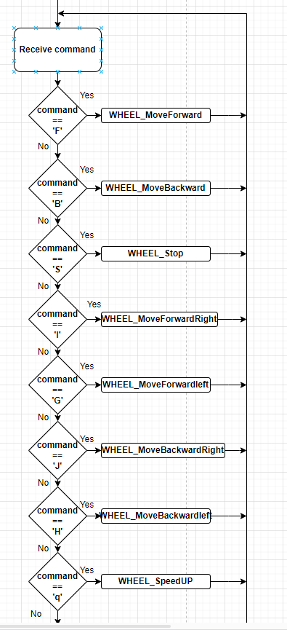
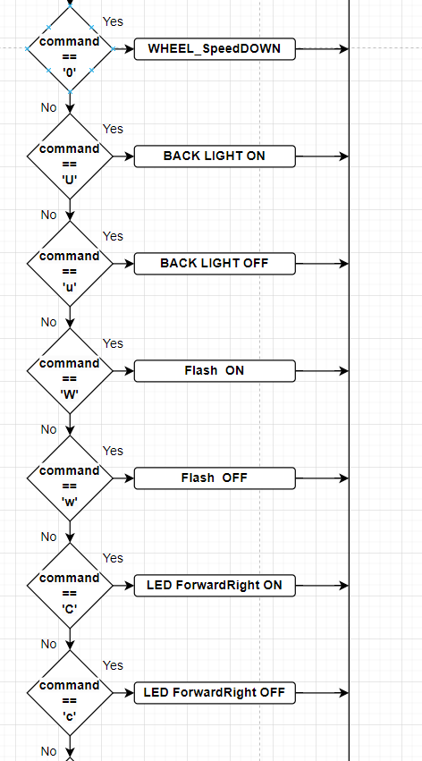
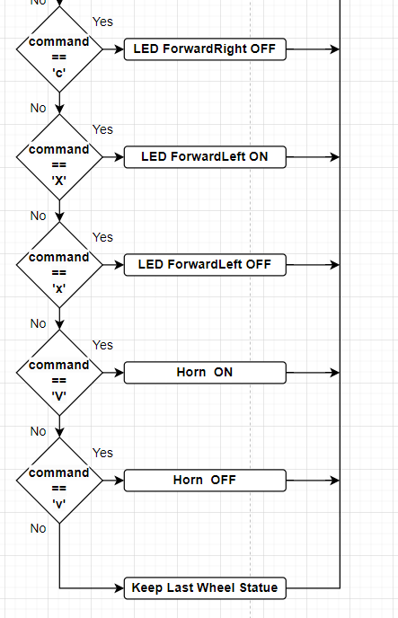
Flow Diagram (Bluetooth Mode)

Slide 9
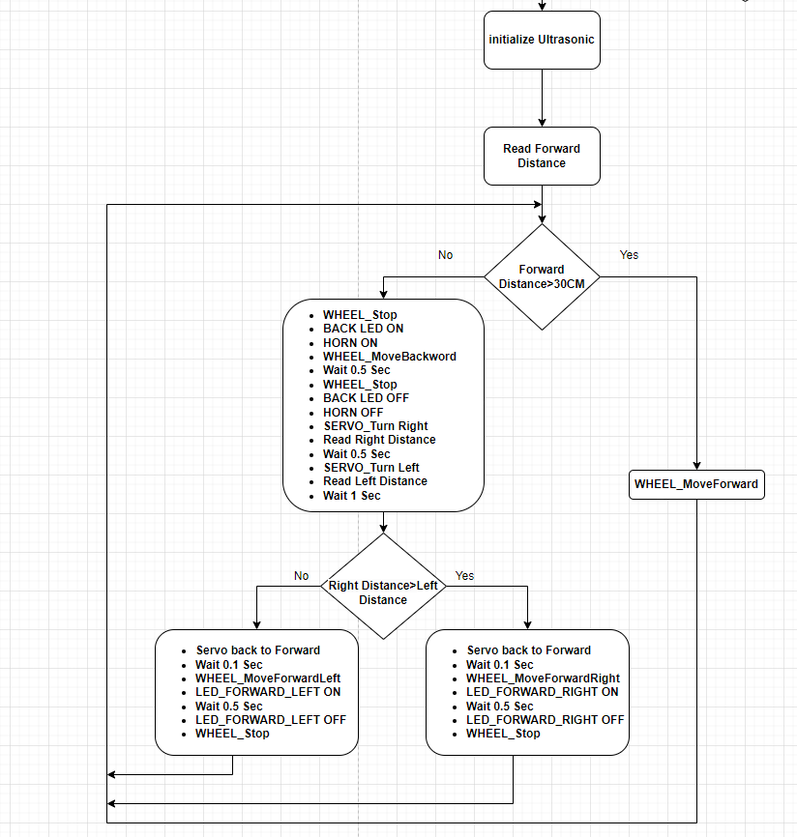
Flow Diagram (Ultrasonic Mode)

Slide 10
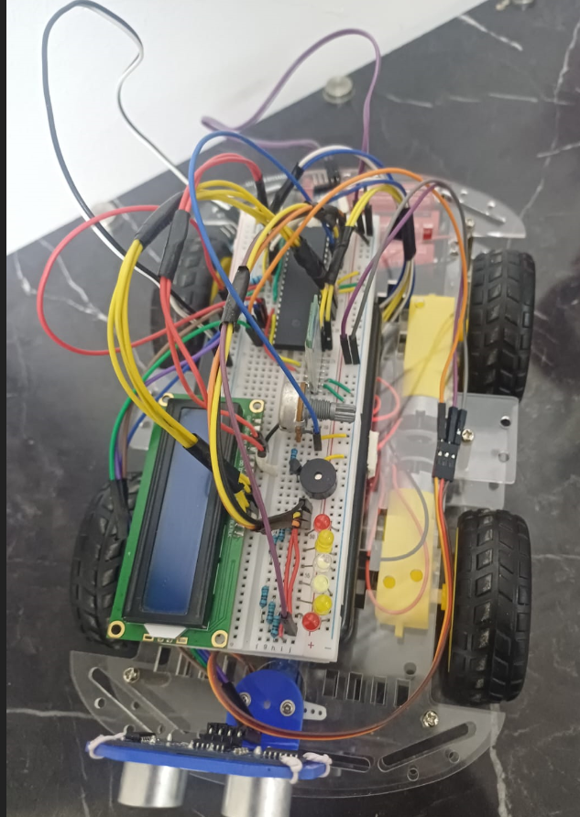
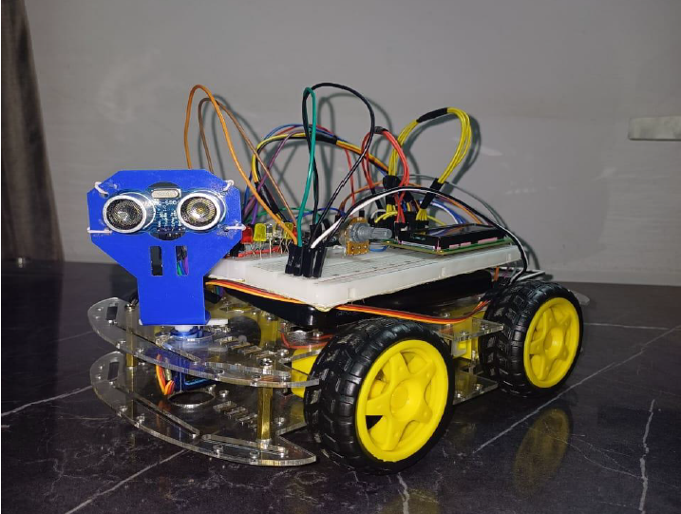
Real-Time Hardware Photo:

Slide 11
Thanks

